Slide 1


Annual General Meeting
2021/2022
Due to the number of attendees, only presenters can unmute
All attendees can turn their camera on and off
Please use the chat function to ask any questions

Slide 2

Housekeeping
  This meeting is not being recorded.
  A copy of the meeting minutes and presentation will be shared with all members following the AGM.
Due to the number of attendees, only presenters can unmute
All attendees can turn their camera on and off
Please use the chat function to ask any questions

Slide 3
Welcome
  AGM Agenda:
  Chair’s Report
  Treasurer’s Report
  Secretary’s Report
  Tenants’ Update
  Vice Chair’s Report
  Closing Remarks

Slide 4
Chair’s Report
  Matty Cockburn
  Our journey so far | Our look ahead

Slide 5
Chair’s Report: Our Progress So Far
May 2021
First Steering Board Meeting
Fundraising
Survey
July 2021
Undertake Building Survey
Become Incorporated
September 2021
Duck Race Fundraiser
Bank Account Opened
Building Works Quoted
April 2021
Kick Off Meeting Pledges in Principle
June 2021
Draft Business Plan
Apply for ‘Asset of Community Value’
Village Trail Fundraiser
August 2021
Asset of Community Value Approved
Submit Our First Application to the Community Ownership Fund
Community Fun Day
February 2022
Share Certificates Delivered
Second COF Bid
November 2021
Website & Facebook Page Created
Standard Mark Obtained for Our Business Plan and Share Offer
Share Offer Launches
October 2021
Unsuccessful Bid to COF
January 2022
Share Certificates Created
COF Feedback Gained
December 2021
Share Offer Closes After Reaching Target
September 2022
Pub Purchase
Completed!
May 2022
Successful COF Bid
Revised Quotes for Buildings Work
June 2022
Conveyancing Starts
Claim with COF Starts
July 2022
Tenancy Agreed
Milestones Agreed
August 2022
Buildings Insurance
Audits
Site Visits With Specialist Suppliers

Slide 6
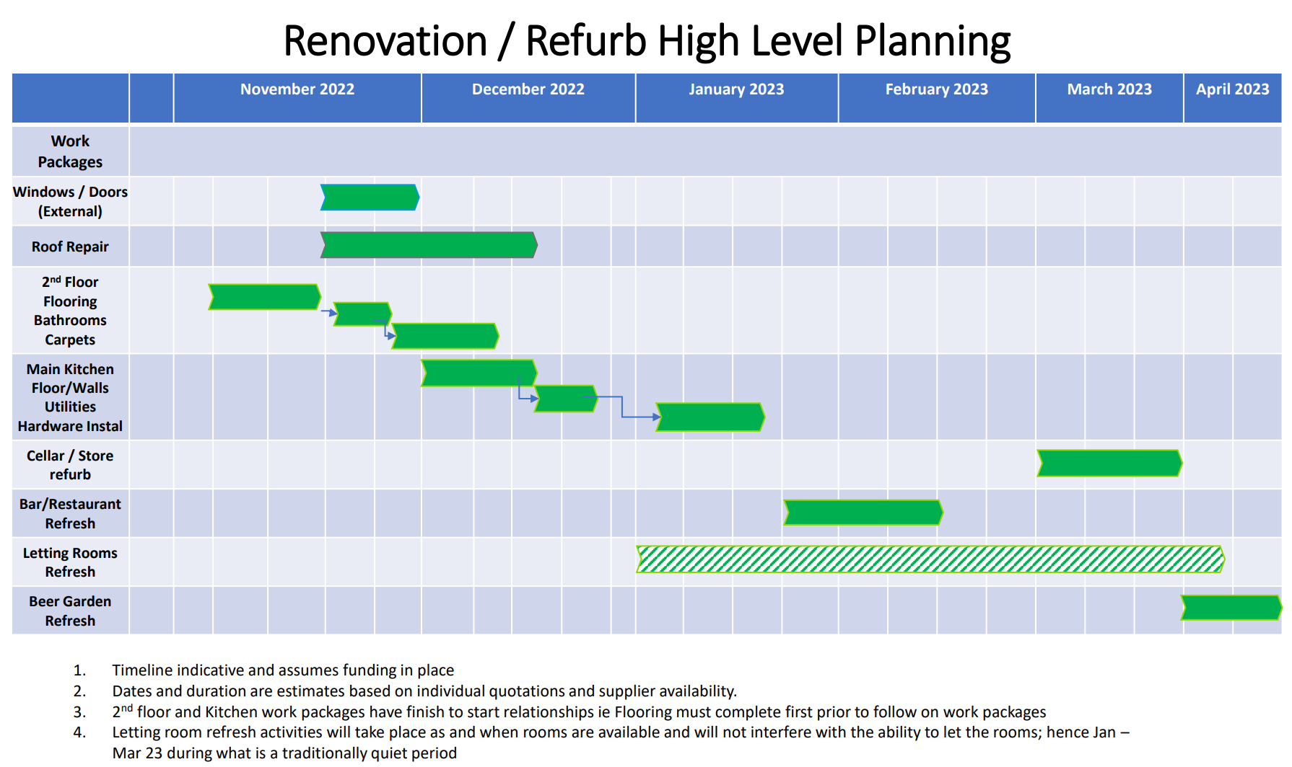
Chair’s Report: Our Look Ahead

Slide 7
Treasurer’s Report
  Katie O’Connell
  Approval of accounts | Appointment of accountant & auditor

Slide 8
Treasurer’s Report: Approval of Accounts
Income | + £7,275
Donations | + £2,739
Fundraising | + £2,850
Quiz/Raffle | + £455
Gin Night | + £913
Duck Race | + £318
Overheads | - £2,397
Insurance | - £353
Repairs & Maintenance | - £95
Printing, Postage & Stationery | - £526
Sundry Expenses | - £91
Bank Charges | - £2
Subscriptions | - £84
Formation Costs | - £646
Accountancy Fees | - £600
Expenses | - £491
Fundraising | - £260
Gin Night | - £231
Profit on Company Trading | + £4,387
Gross Profit | + £6,784
Debtors | - £2,598

Slide 9
Treasurer’s Report: Appointments
  Each year, the society must submit its annual accounts to the FCA.
  The committee has appointed Ian Crisop (Richmond) as our accountant.
  Accounts for the last financial year have been submitted and accepted by the FCA.
  Each year, members are required to vote on the appointment of an accountant and auditor.
  The committee recommends members vote to reappoint Ian Crisop as our accountant.
  Members can also vote to optionally appoint an auditor – this is in addition to an accountant and separate to our annual accounts return.
  The committee recommends members do not vote to appoint an auditor, as this is not compulsory and is estimated to cost an additional £2,000-£3,000 – members’ funds we believe could be better spent.

Slide 10
Secretary’s Report
  Esme Terry
  Management Committee Elections | Voting | Communications

Slide 11
Secretary’s Report: Management Committee Elections
  There are currently 10 management committee members.
  Our model rules allow for a maximum of 12 committee members.
  Two existing members will be standing down.
  All other committee members are standing for re-election.
  Nominations have been received from 3 new candidates.
  Each member can vote for a maximum of 12 candidates.

Slide 12
Secretary’s Report: Voting Arrangements
  All members will receive an email with a link to a secure Microsoft voting form.
  Each member can only submit one vote.
  The exception to this is whereby someone may be a member as both an individual and as a company/business and holds two membership numbers. In this case, they may submit a vote under each membership entity.
  Voting is now open, and will close at 10pm on Thursday 27th October 2022.
  Voting results will be shared with members by email afterwards.
  Paper voting forms are available upon request.

Slide 13
Secretary’s Report: Voting Arrangements
  Points to be decided by the membership vote:
  Election of the management committee
  Appointment of an accountant
  Appointment of an auditor
  The committee’s recommendations:
  The committee recommends members vote to appoint Ian Crisop as our accountant for the next financial year.
  The committee recommends members vote against appointing an auditor.

Slide 14
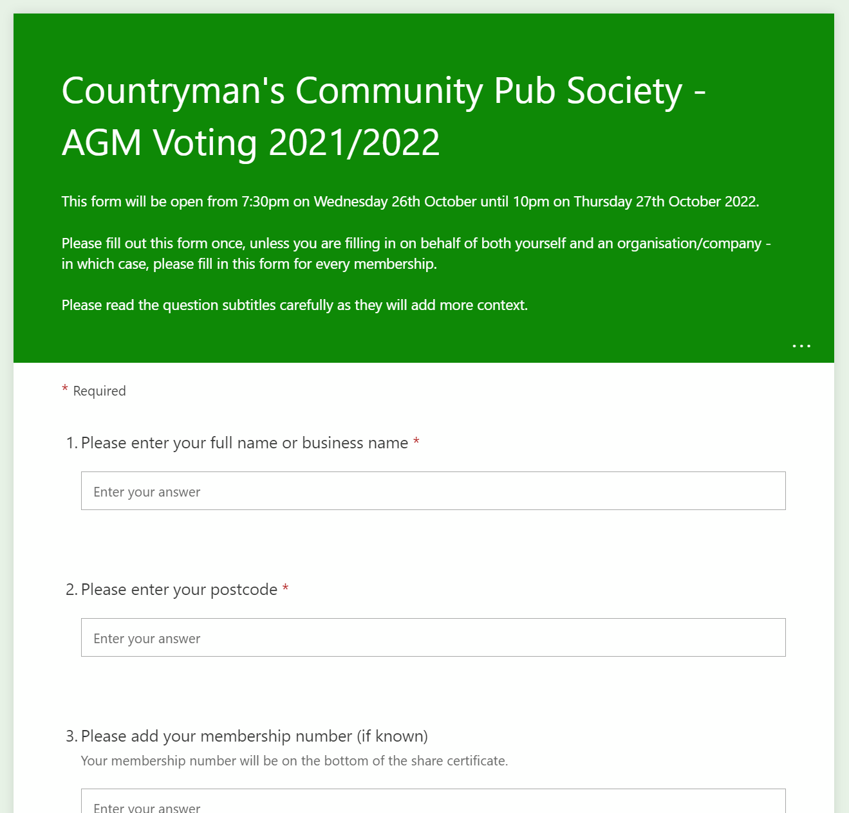
Secretary’s Report: Voting Arrangements
  To vote, you will need to enter:
  Your name
  Your postcode
  Your membership number from your share certificate (this is optional but helps us to verify your vote)

Slide 15
Secretary’s Report: Communications Improvements
  The committee is aware of a recent communications issue whereby members were sent an email using the ‘CC’ function, rather than the ‘BCC’ function.
  To prevent this from recurring, the committee is exploring the possibility of utilising professional communications tools, such as Mailchimp.
  The committee is currently assessing different solutions from a cost and information governance point of view.

Slide 16
Update from Our Tenants
  Daniel Male & Lisa Lowry

Slide 17
Vice Chair’s Report
  Chris Heap
  Members’ questions and Additional resolutions

Slide 18
Vice Chair’s Report: Member Question 1
  “My questions concern the land behind the pub.
  It had been suggested that some of the land at the back of the pub could be used as a community garden, as well as a kitchen garden for the pub restaurant.
  Is this still part of the plan?
  If so, is funding available or will it be sought?
  What is the timescale?”

Slide 19
Vice Chair’s Report: Member Question 2
  “Any news on disabled access?”

Slide 20
Vice Chair’s Report: Member Question 3
  “Are there any plans for a smoking shelter to enable smokers to smoke away from the front door?
  It drifts into the building and is not pleasant to walk through for visitors to the pub.”

Slide 21
Vice Chair’s Report: Member Question 4
  “Bearing in mind that the kitchen will become operational, are there plans to move the monthly quiz away from the Saturday night slot?
  It books up the pub on a peak weekend night and limits non-quiz participants.”

Slide 22
Closing Remarks
  Katie O’Connell
  AOB | Q&A

Slide 23
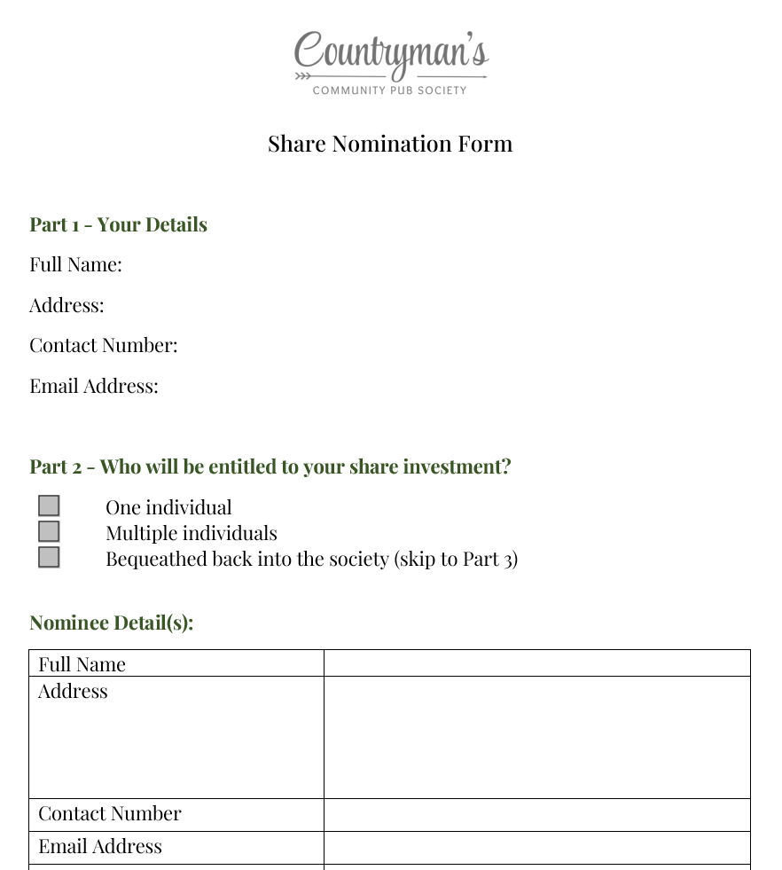
Closing Remarks: Share Nomination Process
  Share Nomination Forms are now available.
  A copy of the nomination form will be distributed to members with the AGM minutes, and will be available on the CCPS website.

Slide 24
Closing Remarks: AOB
  Q&A

Slide 25
Thank You
  The CCPS Management Committee

